Slide 1
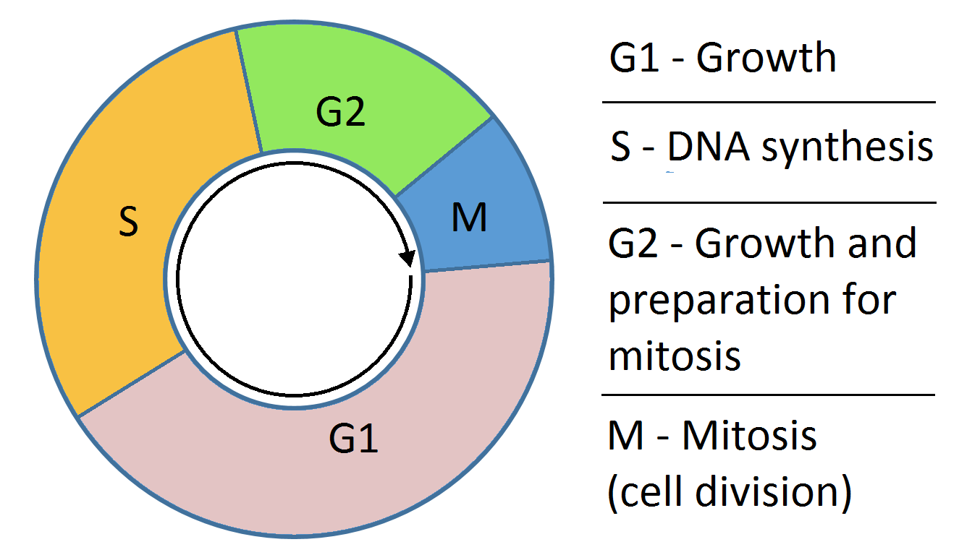
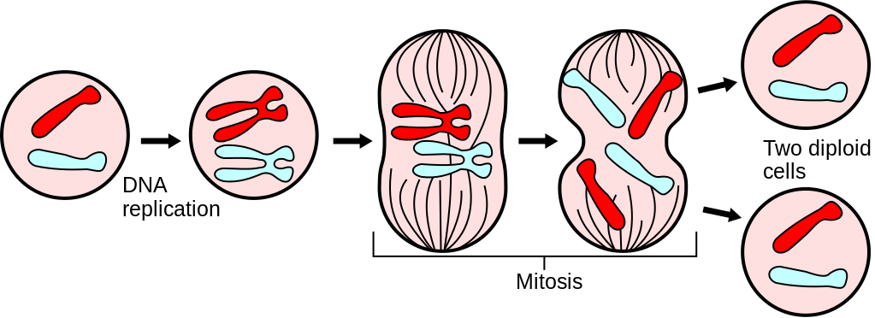
A Mathematical Description of Regulation of the G1-S Transition of the Mammalian Cell Cycle
Presented by: Mike Huang, Chih-Chi Liu

Slide 2
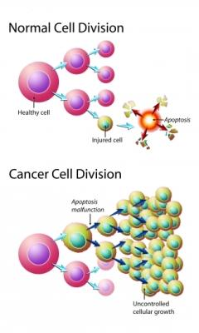
Background
Cell cycle contains many checkpoints that must be met to ensure all of the requisite processes occurs before cell division continues.
Errors result in uncontrolled growth - cancer

Slide 3
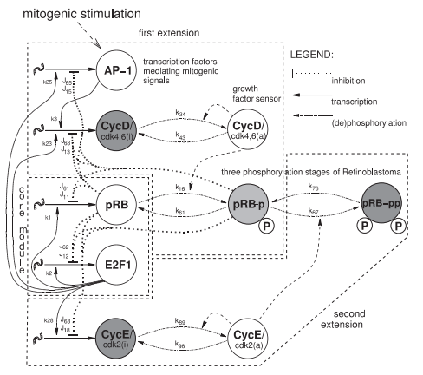
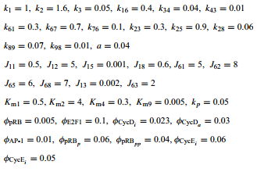
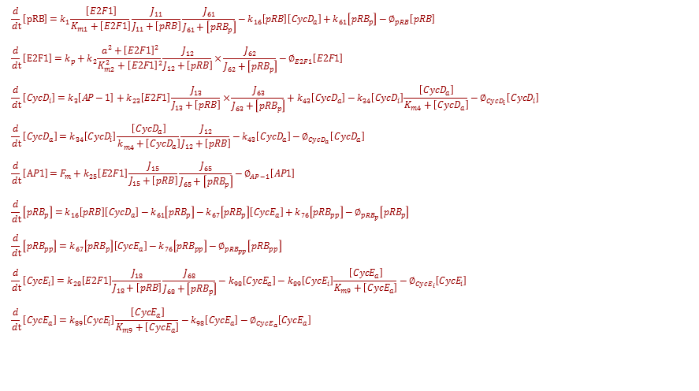
Schematics of the Model
$$\frac{d}{dt}\left[pRB\right]=k_{1}\frac{\left[E2F1\right]}{K_{m1}+\left[E2F1\right]}\frac{J_{11}}{J_{11}+\left[pRB\right]}\frac{J_{61}}{J_{61}+\left[{pRB}_{p}\right]}−k_{16}\left[pRB\right]\left[{CycD}_{a}\right]+k_{61}\left[{pRB}_{p}\right]−∅_{pRB}\left[pRB\right]$$
$$\frac{d}{dt}\left[E2F1\right]=k_{p}+k_{2}\frac{{a^{2}+\left[E2F1\right]}^{2}}{K_{m2}^{2}+{\left[E2F1\right]}^{2}}\frac{J_{12}}{J_{12}+\left[pRB\right]}×\frac{J_{62}}{J_{62}+\left[{pRB}_{p}\right]}−∅_{E2F1}\left[E2F1\right]$$
$$\frac{d}{dt}\left[{CycD}_{i}\right]=k_{3}\left[AP−1\right]+k_{23}\left[E2F1\right]\frac{J_{13}}{J_{13}+\left[pRB\right]}×\frac{J_{63}}{J_{63}+\left[{pRB}_{p}\right]}+k_{43}\left[{CycD}_{a}\right]−k_{34}\left[{CycD}_{i}\right]\frac{\left[{CycD}_{a}\right]}{K_{m4}+\left[{CycD}_{a}\right]}−∅_{{CycD}_{i}}\left[{CycD}_{i}\right]$$
$$\frac{d}{dt}\left[{CycD}_{a}\right]=k_{34}\left[{CycD}_{i}\right]\frac{\left[{CycD}_{a}\right]}{k_{m4}^{}+\left[{CycD}_{a}\right]}\frac{J_{12}}{J_{12}+\left[pRB\right]}−k_{43}\left[{CycD}_{a}\right]−∅_{{CycD}_{a}}\left[{CycD}_{a}\right]$$
$$\frac{d}{dt}\left[AP1\right]=F_{m}+k_{25}\left[E2F1\right]\frac{J_{15}}{J_{15}+\left[pRB\right]}\frac{J_{65}}{J_{65}+\left[{pRB}_{p}\right]}−∅_{AP−1}\left[AP1\right]$$
$$\frac{d}{dt}\left[{pRB}_{p}\right]=k_{16}\left[pRB\right]\left[{CycD}_{a}\right]−k_{61}\left[{pRB}_{p}\right]−k_{67}\left[{pRB}_{p}\right]\left[{CycE}_{a}\right]+k_{76}\left[{pRB}_{pp}\right]−∅_{{pRB}_{p}}\left[{pRB}_{p}\right]$$
$$\frac{d}{dt}\left[{pRB}_{pp}\right]=k_{67}\left[{pRB}_{p}\right]\left[{CycE}_{a}\right]−k_{76}\left[{pRB}_{pp}\right]−∅_{{pRB}_{pp}}\left[{pRB}_{pp}\right]$$
$$\frac{d}{dt}\left[{CycE}_{i}\right]=k_{28}\left[E2F1\right]\frac{J_{18}}{J_{18}+\left[pRB\right]}\frac{J_{68}}{J_{68}+\left[{pRB}_{p}\right]}−k_{98}\left[{CycE}_{a}\right]−k_{89}\left[{CycE}_{i}\right]\frac{\left[{CycE}_{a}\right]}{K_{m9}+\left[{CycE}_{a}\right]}−∅_{{CycE}_{i}}\left[{CycE}_{i}\right]$$
$$\frac{d}{dt}\left[{CycE}_{a}\right]=k_{89}\left[{CycE}_{i}\right]\frac{\left[{CycE}_{a}\right]}{K_{m9}+\left[{CycE}_{a}\right]}−k_{98}\left[{CycE}_{a}\right]−∅_{{CycE}_{a}}\left[{CycE}_{a}\right]$$
3

Slide 4
Specific Aims of the Study
Study the significance of cyclin D and cyclin E by overexpressed them in the G1/S transition
Perform the bifurcation analysis
Can the framework make predictions that can lead to interventions to tumorigenesis?
4

Slide 5
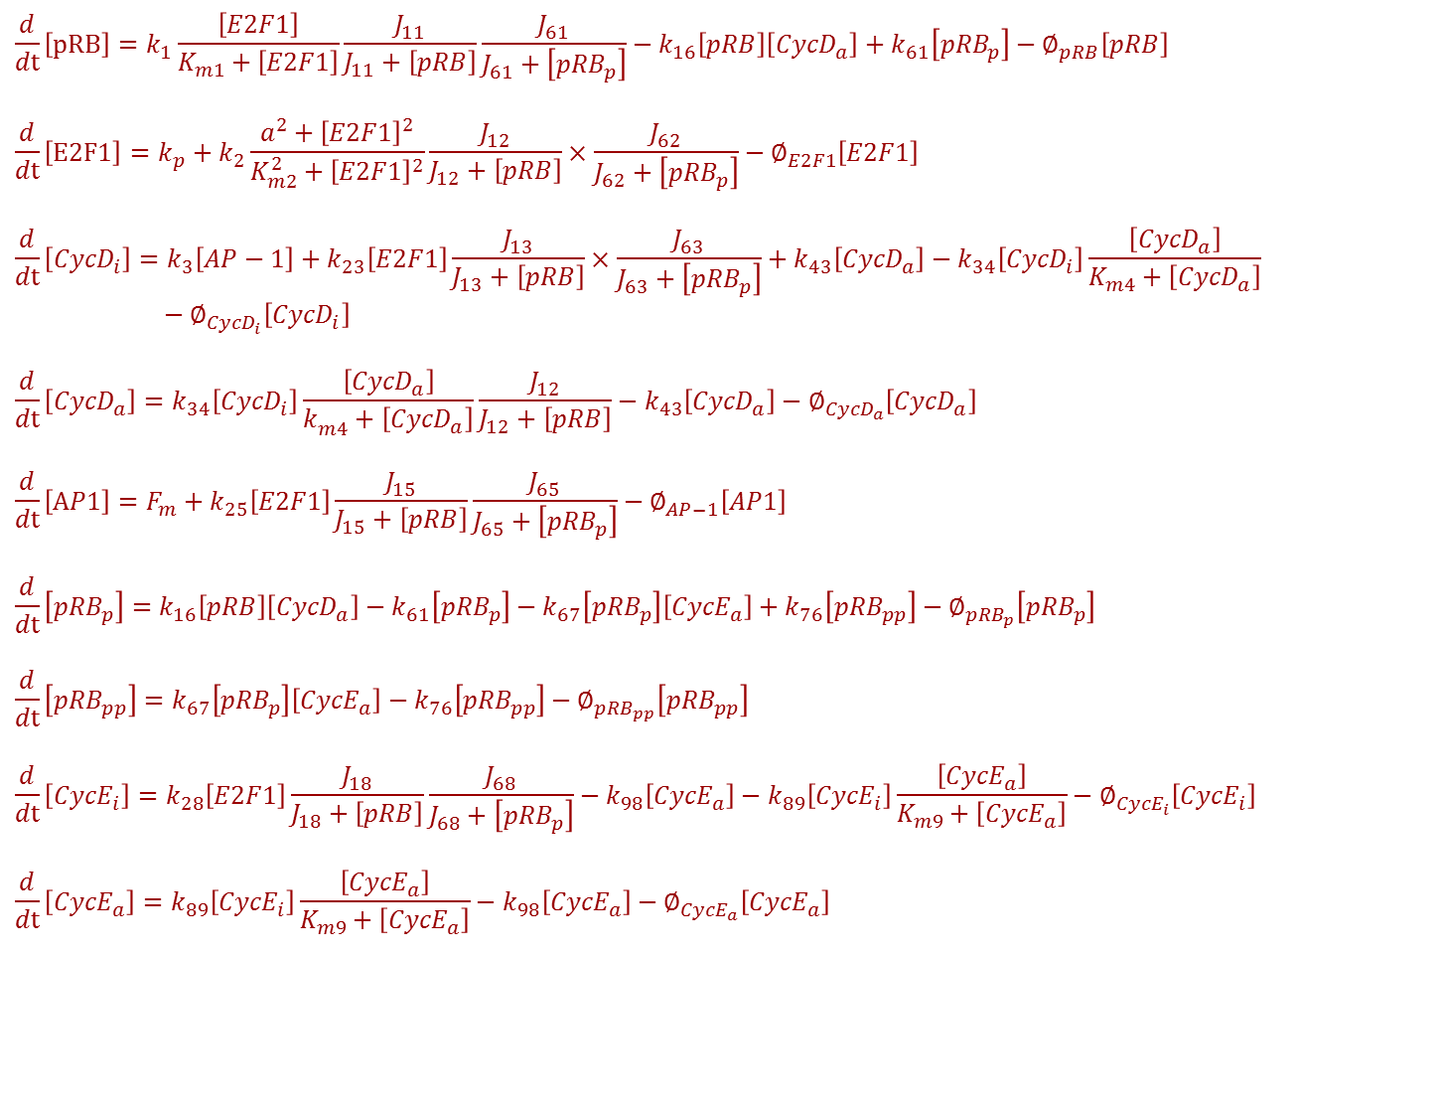
$$\frac{d}{dt}\left[pRB\right]=k_{1}\frac{\left[E2F1\right]}{K_{m1}+\left[E2F1\right]}\frac{J_{11}}{J_{11}+\left[pRB\right]}\frac{J_{61}}{J_{61}+\left[{pRB}_{p}\right]}−k_{16}\left[pRB\right]\left[{CycD}_{a}\right]+k_{61}\left[{pRB}_{p}\right]−∅_{pRB}\left[pRB\right]$$
$$\frac{d}{dt}\left[E2F1\right]=k_{p}+k_{2}\frac{{a^{2}+\left[E2F1\right]}^{2}}{K_{m2}^{2}+{\left[E2F1\right]}^{2}}\frac{J_{12}}{J_{12}+\left[pRB\right]}×\frac{J_{62}}{J_{62}+\left[{pRB}_{p}\right]}−∅_{E2F1}\left[E2F1\right]$$
$$\frac{d}{dt}\left[{CycD}_{i}\right]=k_{3}\left[AP−1\right]+k_{23}\left[E2F1\right]\frac{J_{13}}{J_{13}+\left[pRB\right]}×\frac{J_{63}}{J_{63}+\left[{pRB}_{p}\right]}+k_{43}\left[{CycD}_{a}\right]−k_{34}\left[{CycD}_{i}\right]\frac{\left[{CycD}_{a}\right]}{K_{m4}+\left[{CycD}_{a}\right]}−∅_{{CycD}_{i}}\left[{CycD}_{i}\right]$$
$$\frac{d}{dt}\left[{CycD}_{a}\right]=k_{34}\left[{CycD}_{i}\right]\frac{\left[{CycD}_{a}\right]}{k_{m4}^{}+\left[{CycD}_{a}\right]}\frac{J_{12}}{J_{12}+\left[pRB\right]}−k_{43}\left[{CycD}_{a}\right]−∅_{{CycD}_{a}}\left[{CycD}_{a}\right]$$
$$\frac{d}{dt}\left[AP1\right]=F_{m}+k_{25}\left[E2F1\right]\frac{J_{15}}{J_{15}+\left[pRB\right]}\frac{J_{65}}{J_{65}+\left[{pRB}_{p}\right]}−∅_{AP−1}\left[AP1\right]$$
$$\frac{d}{dt}\left[{pRB}_{p}\right]=k_{16}\left[pRB\right]\left[{CycD}_{a}\right]−k_{61}\left[{pRB}_{p}\right]−k_{67}\left[{pRB}_{p}\right]\left[{CycE}_{a}\right]+k_{76}\left[{pRB}_{pp}\right]−∅_{{pRB}_{p}}\left[{pRB}_{p}\right]$$
$$\frac{d}{dt}\left[{pRB}_{pp}\right]=k_{67}\left[{pRB}_{p}\right]\left[{CycE}_{a}\right]−k_{76}\left[{pRB}_{pp}\right]−∅_{{pRB}_{pp}}\left[{pRB}_{pp}\right]$$
$$\frac{d}{dt}\left[{CycE}_{i}\right]=k_{28}\left[E2F1\right]\frac{J_{18}}{J_{18}+\left[pRB\right]}\frac{J_{68}}{J_{68}+\left[{pRB}_{p}\right]}−k_{98}\left[{CycE}_{a}\right]−k_{89}\left[{CycE}_{i}\right]\frac{\left[{CycE}_{a}\right]}{K_{m9}+\left[{CycE}_{a}\right]}−∅_{{CycE}_{i}}\left[{CycE}_{i}\right]$$
$$\frac{d}{dt}\left[{CycE}_{a}\right]=k_{89}\left[{CycE}_{i}\right]\frac{\left[{CycE}_{a}\right]}{K_{m9}+\left[{CycE}_{a}\right]}−k_{98}\left[{CycE}_{a}\right]−∅_{{CycE}_{a}}\left[{CycE}_{a}\right]$$

Slide 6
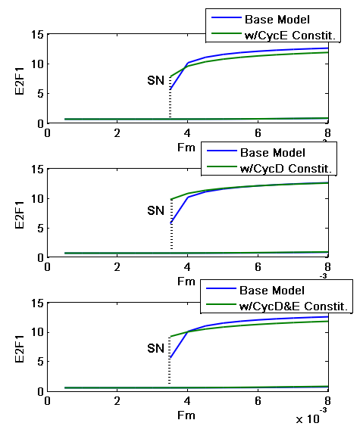
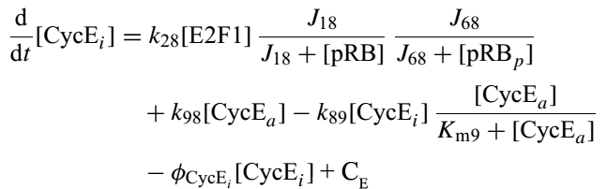
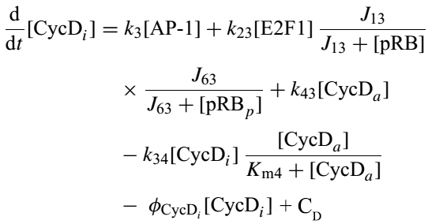
Extended from Prior Model
6
Notes:
List 9 important components
Run through the mechanisms
Authors cite past experimental studies that rigorously determined a range of molecules and processes in the network
Authors selected nine of these components they “believed” to be the most important in controlling the G1-S transition

Slide 7
Assumption and Limitation of the Method
No validation research to support the balance between a constitutive synthesis rate and the E2F1 dependent synthesis rate
No quantitative experimental data provided for validation of the bistability
Number mechanisms are conflict with the mechanisms used in other paper
pRB was shown to positively autoregulated by itself in Park’s research

Slide 8
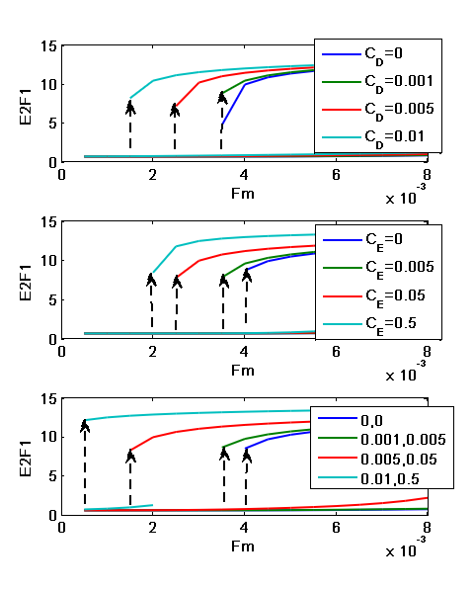
Results: Overexpression in the cyclin D and Cyclin E Changed the SN
Overexpressing the Constitutive Synthesis of Cyclins shortening the G1 phase
Cyclin D (Top)
Cyclin E (Middle)
Both Cyclin D & Cyclin E

Slide 9
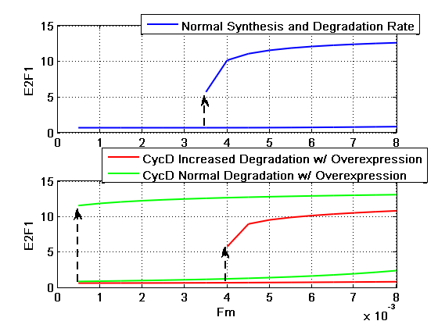
Results: Inducing Degradation in Cyclin D
Inducing degradation of cyclin D prevent cell proliferation
Repression of Cyclin D shifted the SN to the right
Pharmaceuticals such as Troglitazone, Anasamycin, and Monoterpenes play the role of degrading the cyclin D
9

Slide 10
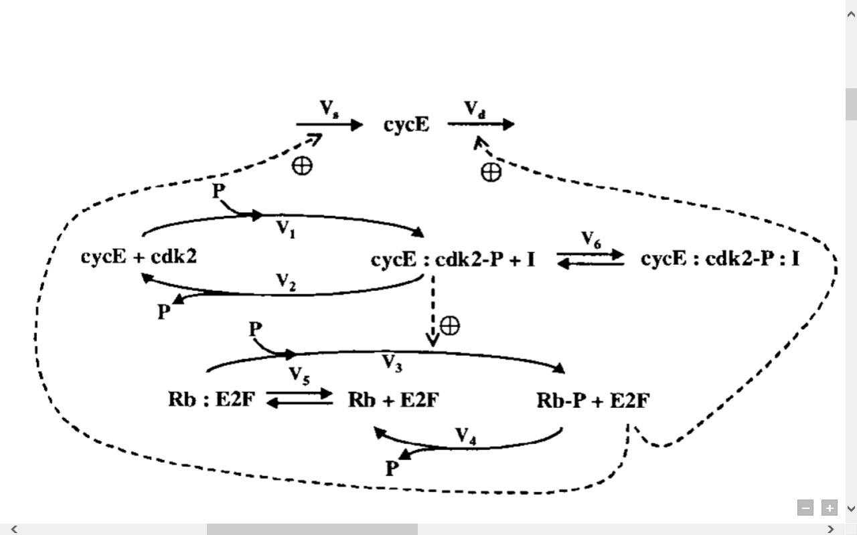
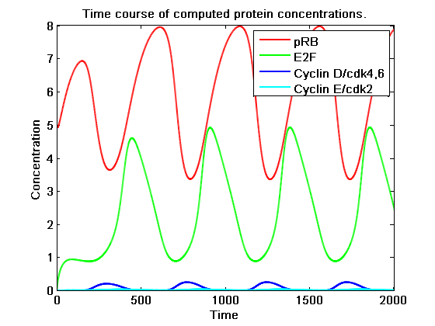
Result: Negative Feedback to show cell cycle oscillation
Couple of positive feedback mechanism to a negative feedback loop shows cell cycle oscillation
Require more study to develop the mechanism on how cyclins repressed by E2F

Slide 11
Limitations of Study
The model is incomplete and simplified
Number of mechanisms and bimolecular interactions found in other paper is neglected
The model makes the assumption of double-inhibition double activation interactions between E2F1-pRB as a way to generate bistability
The parameter aren’t measured but rather are qualitative to have certain qualitative feature
There is no qualitative data validation

Slide 12
Path Forward
Study the significance of cdk2/cdk4,6 in the G1/S transition by adding inhibitors to the phosphorylation
Varying the parameter of k₃₄/k₄₃ for cyclin D and k₉₈/k₈₉ for cyclin E
Study the negative feedback that leads to cell quiescence
12

Slide 13
Citation
Thank you!
Questions?
13

